Slide 1
OTC Market Case Study Reflection
By: Robert, Faisal, Protoy, & Yash

Slide 2
Agenda
Preliminary Information
Business Requirements
Pipeline
Challenges Encountered
Concluding Thoughts

Slide 3
Preliminary Information
OTC Market Transactions are buying/selling assets directly between the two parties.
Notable fields are Caveat Emptor, OTC Tier, and DAD/PAL
End-of-Day file data was used in this analysis
End product is still being worked on, this focuses on challenges instead

Slide 4
Business Requirements
Be able to perform in-depth analysis of OTC market transactions
Give insights into OTC market trends and behavior

Slide 5
Pipeline

Slide 6
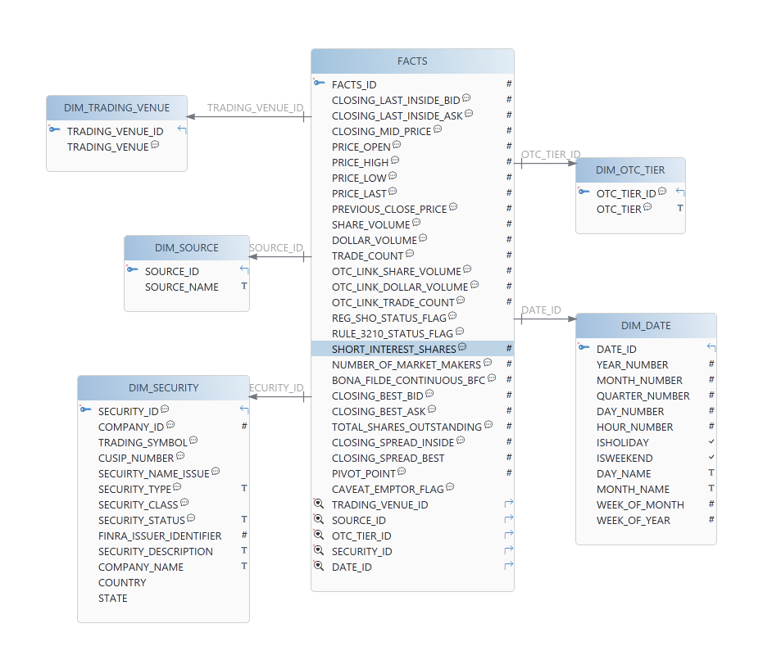
Dimensional Model

Slide 7
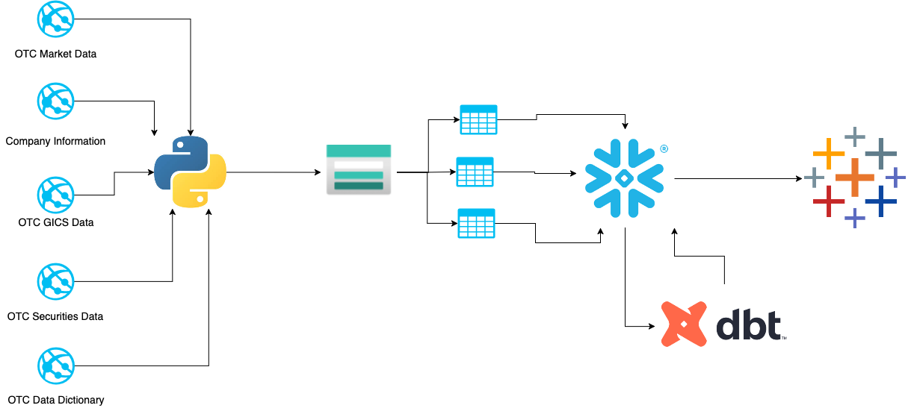
Technical Architecture

Slide 8




Medallion Architecture
Bronze
Raw Data
Silver
Cleaned Data
Gold
Processed Data

Slide 9
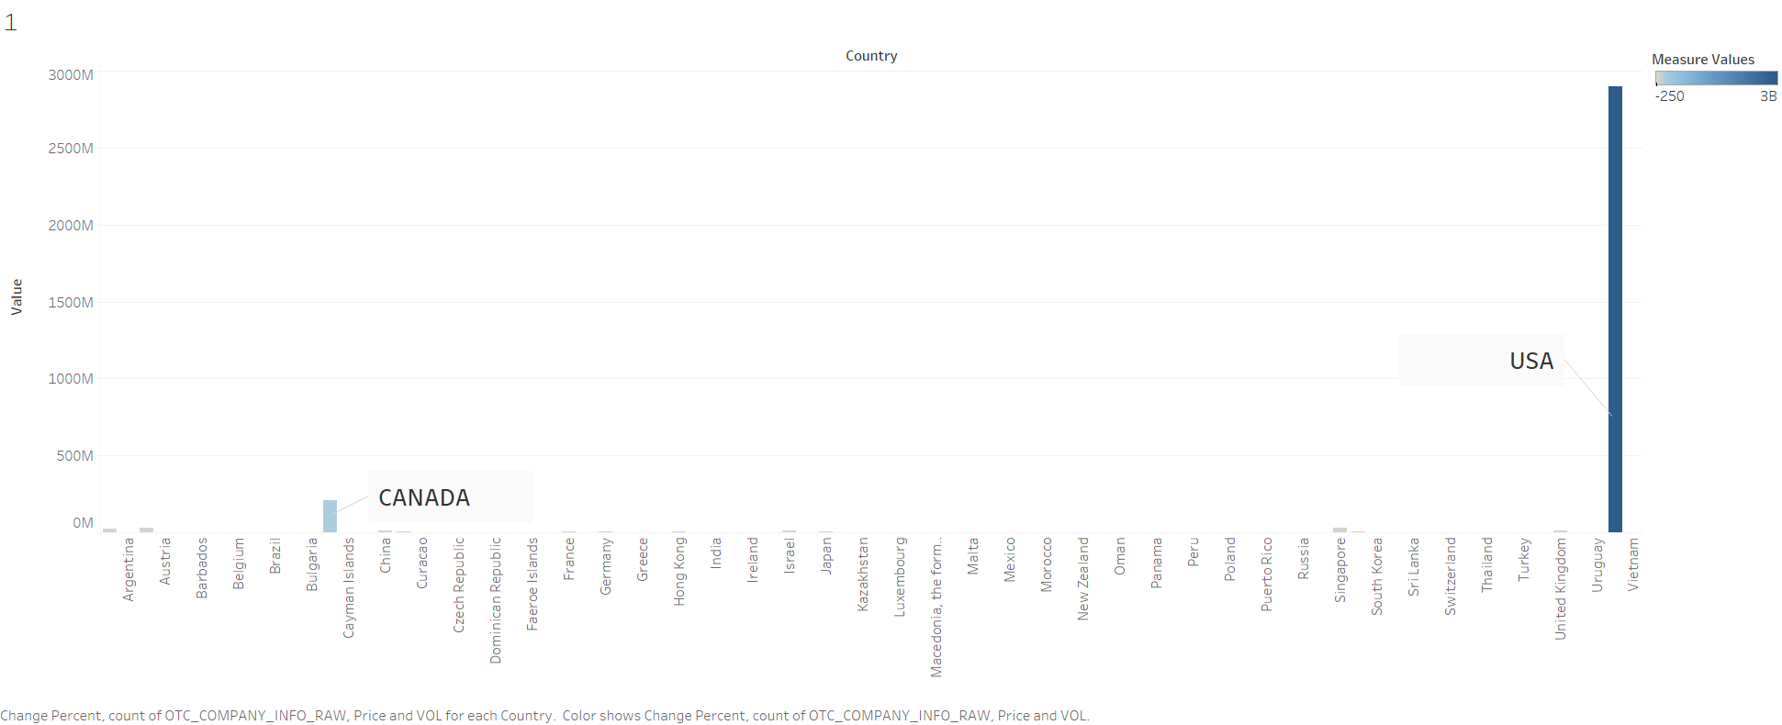
Business Visualizations

Slide 10
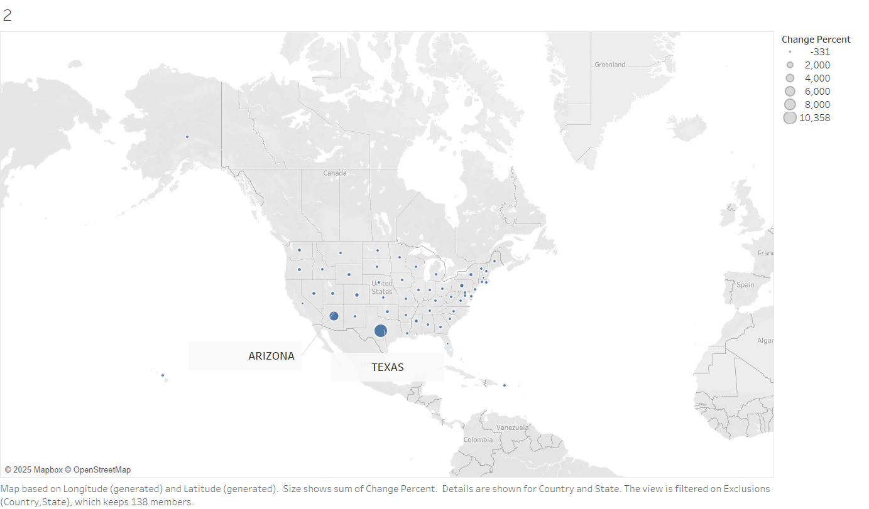
Business Visualizations

Slide 11
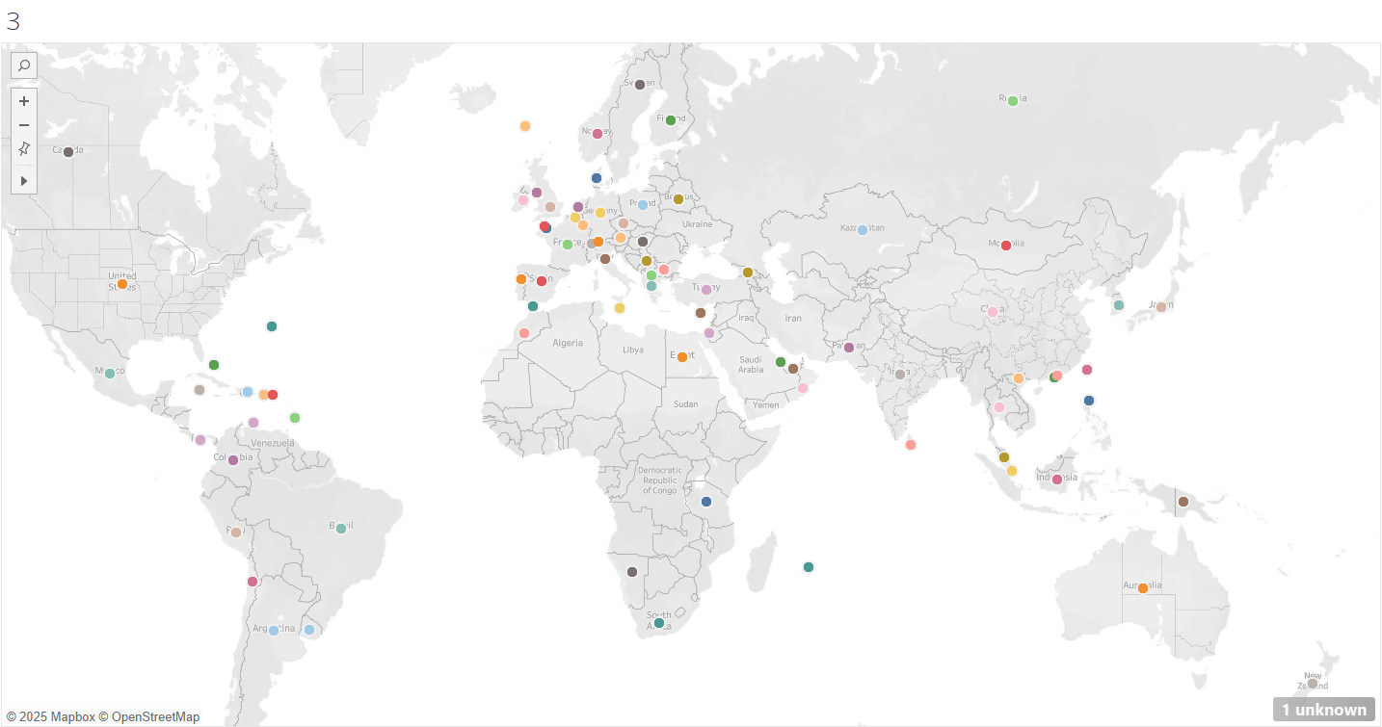
Business Visualizations

Slide 12
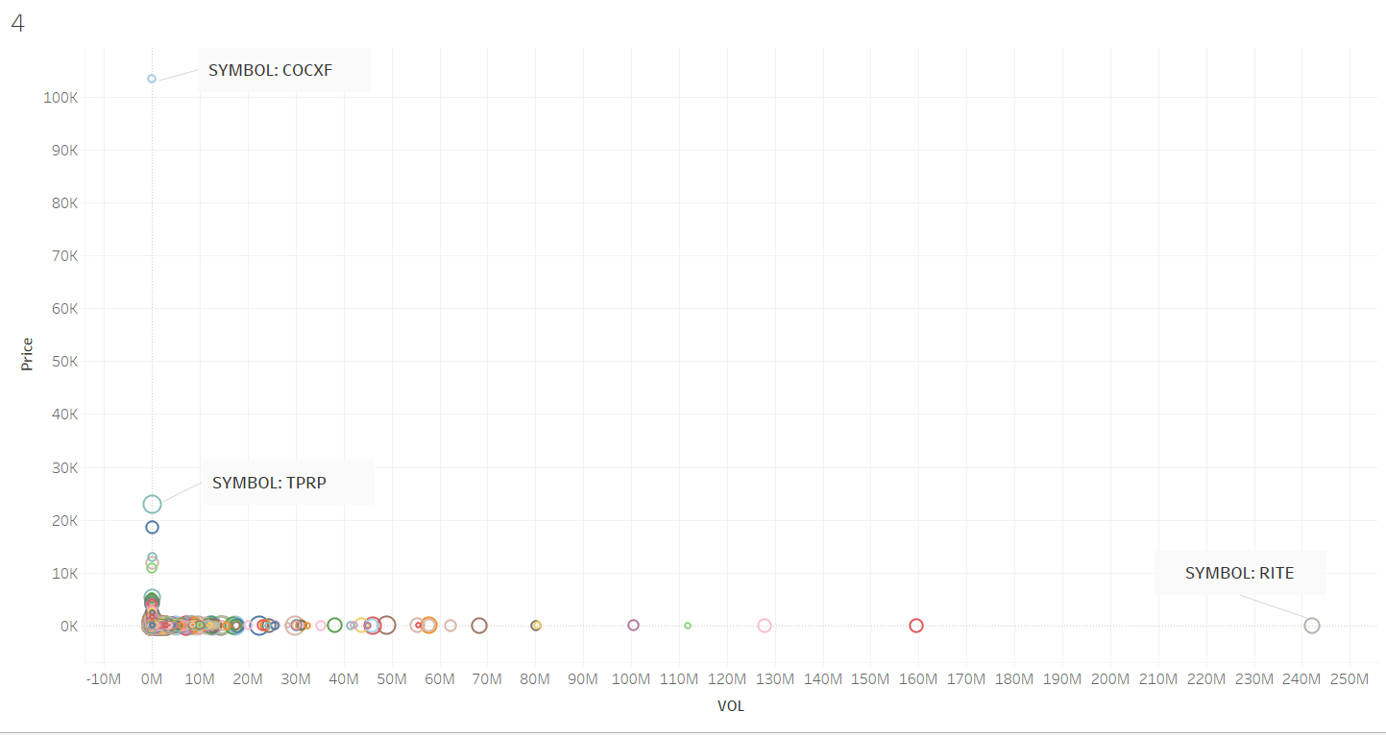
Business Visualizations

Slide 13
Challenges

Slide 14
Conflicts When Making the Product
Azure blobs were not possible to share
Unable to upload facts table to Snowflake
Tableau Public is difficult to work with

Slide 15
Conclusion

Slide 16
What We Learned
Make artificial deadlines
Always ask for help
Adapt to last minute changes
SQL is fun :)

Slide 17
Thank You!

